Slide 1


Corporate Presentation September 2021
TSXV: NHHH OTCQB: NHHHF
•

Slide 2
Disclaimer
Certain statements and documents referred to in this presentation, other than statements of historical fact, may include forward-looking information that involves various risks and uncertainties that face the Company; such statements may contain such words as "may", "would", "could", "will", "intend", "plan", "anticipate", "believe", "estimate", "expect" and similar expressions, and may be based on management's current assumptions and expectations related to all aspects of the automotive and capacitor industries, consumer demand for zero emission transportation solutions and the global economy. Risks and uncertainties that may face the Company include, but are not restricted to: the Company may not be able to replicate test results in mass produced commercial products; the Company’s energy storage and fuel technology may not be successfully commercialized at all, in a manner providing the features and benefits expected while under development, or on a timely basis or the Company may not be able to successfully incorporate this technology into its current or proposed products or the products of others; steps taken by the Company to protect its proprietary rights may not be adequate or third parties may infringe or misappropriate the Company's proprietary rights; the Company has a history of losses from operations and may not be able to obtain financing, if and when required or on acceptable terms due to market conditions or other factors, to fund future expenditures for general administrative activities, including sales and marketing and research and development, expansion, strategic acquisitions or investment opportunities or to respond to competitive pressures; competitors may develop products which offer greater benefits to consumers, have greater market appeal or are more competitively priced than those offered by the Company; the Company may be exposed to product liability claims which exceed insurance policy limits; the Company is dependent on the ability and experience of a relatively small number of key personnel; new products introduced by the Company may not be accepted in the market or to the extent projected; new laws and regulations may be enacted or existing ones may be applied or governmental action may be taken in a manner which could limit or curtail the production or sale of the Company's products; and the Company may be negatively affected by reduced consumer spending due to the uncertainty of economic and geopolitical conditions. These risks and uncertainties may cause actual results to differ from information contained in this presentation, when estimates and assumptions have been used to measure and report results. There can be no assurance that any statements of forward-looking information contained in this presentation will prove to be accurate. Actual results and future events could differ materially from those anticipated in such statements.
These and all subsequent written and oral statements containing forward-looking information are based on the estimates and opinions of management on the dates they are made and expressly qualified in their entirety by this notice. Except as required by applicable laws, the Company assumes no obligation to update forward-looking statements should circumstances or management's estimates or opinions change. Readers are cautioned not to place undue reliance on any statements of forward looking information that speak only as of the date of this presentation. Additional information identifying risks and uncertainties relating to the Company's business are contained under the heading "Risk Factors" in the Company's filings with the various Canadian securities regulators which are available online at www.sedar.com.
Neither TSX Venture Exchange nor its Regulation Services Provider (as that term is defined in the policies of the TSX Venture Exchange) accepts responsibility for the adequacy or accuracy of this release.
TSXV: NHHH OTCQB: NHHHF
•
Notes:
I’ve run out of disclaimer jokes so please read this at your leisure

Slide 3
September 4, 2021
October 5, 2021
August 9, 2021
August 10, 2021
October 5, 2021

Slide 4


Who are we?
Canadian-based technology, growth stage company, operating internationally
Identifying practical solutions
Clean
Sustainable
Economically viable
Can be implemented now
Initial core technology is carbon-free ammonia (NH3)
Green ammonia
TSXV: NHHH OTCQB: NHHHF
•

Slide 5

Vision
The climate crisis has already been solved.
We already have all the facts and solutions.
All we have to do is wake up and change.
Greta Thunberg
TSXV: NHHH OTCQB: NHHHF
•
Notes:
Sometimes, someone says it so perfectly, you don’t want to change a word. We’ve adopted the wise and provocative words of Greta Thunberg as our corporate vision:
READ GRETA’s WORDS
So, we need to push hard against the resistance that still exists out there and understand that this incredible momentum of change MUST NOT be stopped.

Slide 6

Progressing as Planned
Financing in place
Intellectual Property Protection secured
Growing team of experts
Lead product - Carbon-Free NH3 - in production
Future technologies on horizon
TSXV: NHHH OTCQB: NHHHF
•
Notes:
In this presentation I’ll be going through a number of key areas of progression in our business plan.
The topics I’ll be covering are listed here and I hope many of your questions will be answered as we go through the presentation.
Please also note, as David mentioned, that we’ll have time for some questions at the end of the presentation and for those that we can’t get to today, we will definitely either include them in our frequently asked questions section of our website, which is a very popular section. Or we will get to them in further webinars in the coming months. We’ll also respond to you directly if possible

Slide 7

Financing
Completed C$5 million
U.S. institutional financing
Balance sheet strong
Current cash balance is over C$6 million
Full funding for Phase 2 carbon-free NH3 commercial prototype demonstration systems in hand
Commercial build partner: National Compressed Air
To confirm broad application potential across sectors
Extensive warrants exercised in Q1, Q2
TSXV: NHHH OTCQB: NHHHF
•
Notes:
On the financial front, we just closed a $5 million financing which was fully subscribed with US institutional investors. The result of this is that our balance sheet is strong and we have just over $6 million in operational capital today.
This financing was especially important as we’ve launched our phase 2 demonstration system build with National Compressed Air. With that project underway, we will start spending real dollars building these demonstration systems, with the intention to have a number of them in the field early in 2022 for high profile demonstration programs.
We were also very fortunate to have had strong performance in the stock which resulted in close to $1 million worth of warrants being exercised over the first two of quarters of 2021.

Slide 8

Intellectual Property Protection
Filed comprehensive provisional patent for core carbon-free NH3 technology
Includes other related initiatives to be built upon further and protected
TSXV: NHHH OTCQB: NHHHF
•
Notes:
On the intellectual property front, we filed a key provisional patent on June 8th of this year .
This patent provides for the core protection of our underlying systems and processes. And it also broadens our intellectual property scope with many enhancements to the core technology which will result in further discrete patent protection. We will announce those filings as they develop in the coming months.

Slide 9

Growing Team
Dr. Ibrahim Dincer and team
Dr. Ghassan Chedade
André Mech
Olushola (Shola) Ashiru
Consulting partners
RBMG – Investor Relations
IBN – Communications
Sussex Group – Government Relations
More to come
Staff
Consultants
Advisory committee
TSXV: NHHH OTCQB: NHHHF
•
Notes:
We are incredibly pleased with how the team is evolving and I feel very positive that the group we’re assembling HAS all the necessary requisite skills to deliver on our ambitious business plan.
Most of you will be familiar with Dr. Ibrahim Dincer and his team’s foundational contribution to the scalable and modular carbon-free ammonia systems we are developing today. A couple of days ago, we announced that Andre Mech was joining us to provide strategic guidance on carbon credit and emissions targets on a global scale. His counsel will help us formulate our sector and geographic focus going forward. Andre has already proven to be an incredibly valuable resource for us.
We’ve also been adding some critical consultants related to investor and public relations. And we are also happy to announce that the Sussex group has joined our consulting team focussed on helping us navigate the complex waters of government relations. As you can all imagine, the importance of having government support at every level for our work will help create not only awareness of our solutions, but we expect that meaningful government support will also provide regulatory legitimacy and a shift towards our carbon-free solutions being adopted first and foremost in Canada but, by extension, with government entities around the world.
And as our team continues to grow we will keep all of you up to speed on our new hires and consulting relationships. We’re moving carefully to ensure that we have the best integrated team possible.

Slide 10

Complementary Technologies
Exploring complementary technologies to broaden portfolio of sustainable energy solutions
TSXV: NHHH OTCQB: NHHHF
•
Notes:
And with the combination of our various consultants and the major provisional patent that was filed in June, we our spending a serious amount of strategic planning time looking at complementary technologies that will support and expand our core carbon-free ammonia offering. Our intention over the next couple of years is to invest in and commercialize a range of technologies that will allow for the modular and scalable application of sustainable energy solutions built around Ammonia and Hydrogen technologies and related applications.

Slide 11

Carbon-Free NH3
Our Lead Product
TSXV: NHHH OTCQB: NHHHF
•
Notes:
So, let’s talk about our lead technology and first products related to carbon-free NH3 – also called green ammonia

Slide 12

What’s ammonia?
N + HHH = NH3
Used for over 100 years
200 million tons consumed annually worldwide
80% used in agriculture
Also for textiles, mining feedstock, chemicals production, cleaning materials, pharmaceutical manufacturing, water treatment, fuel, refrigerant
Adaptable to current infrastructure
Easily stored and shipped
TSXV: NHHH OTCQB: NHHHF
•
Notes:
First of all let’s take a moment and at a very rudimentary level, understand the significance of ammonia. Ammonia has been used as a Chemical for over 100 years and today over 200 million tons of ammonia is consumed worldwide. Interestingly, over 80% of the ammonia produced today is used in agriculture. And I’ll explain shortly how we plan to enter into the agricultural markets with solutions that will provide some pretty positive and significant environmental shifts in agriculture today.
Ammonia is also used in a number of other crucial manufacturing processes. And these smaller, yet substantial markets would also benefit greatly from FuelPositive’s carbon-free Ammonia solutions.

Slide 13

Market Size for Traditional Ammonia
200 million tons consumed annually
Existing NH3 market over US $70 billion per year
TSXV: NHHH OTCQB: NHHHF
•
Notes:
Not only is a lot of ammonia produced every year around the world, it has an annual market value of about 70 billion US dollars. The existing Ammonia market has been a commodity type market with compound annual growth rates of about 5% per year.

Slide 14

Market Size for Green Ammonia
Market for green ammonia is predicted to grow at a compound annual growth rate of 54% between 2020 and 2025
Market Study Report LLC
https://www.marketwatch.com/press-release/global-green-ammonia-market-size-to-expand-at-54-of-cagr-by-2025-2021-07-05
TSXV: NHHH OTCQB: NHHHF
•
Notes:
And with the combination of our various consultants and the major provisional patent that was filed in June, we our spending a serious amount of strategic planning time looking at complementary technologies that will support and expand our core carbon-free ammonia offering. Our intention over the next couple of years is to invest in and commercialize a range of technologies that will allow for the modular and scalable application of sustainable energy solutions built around Ammonia and Hydrogen technologies and related applications.

Slide 15
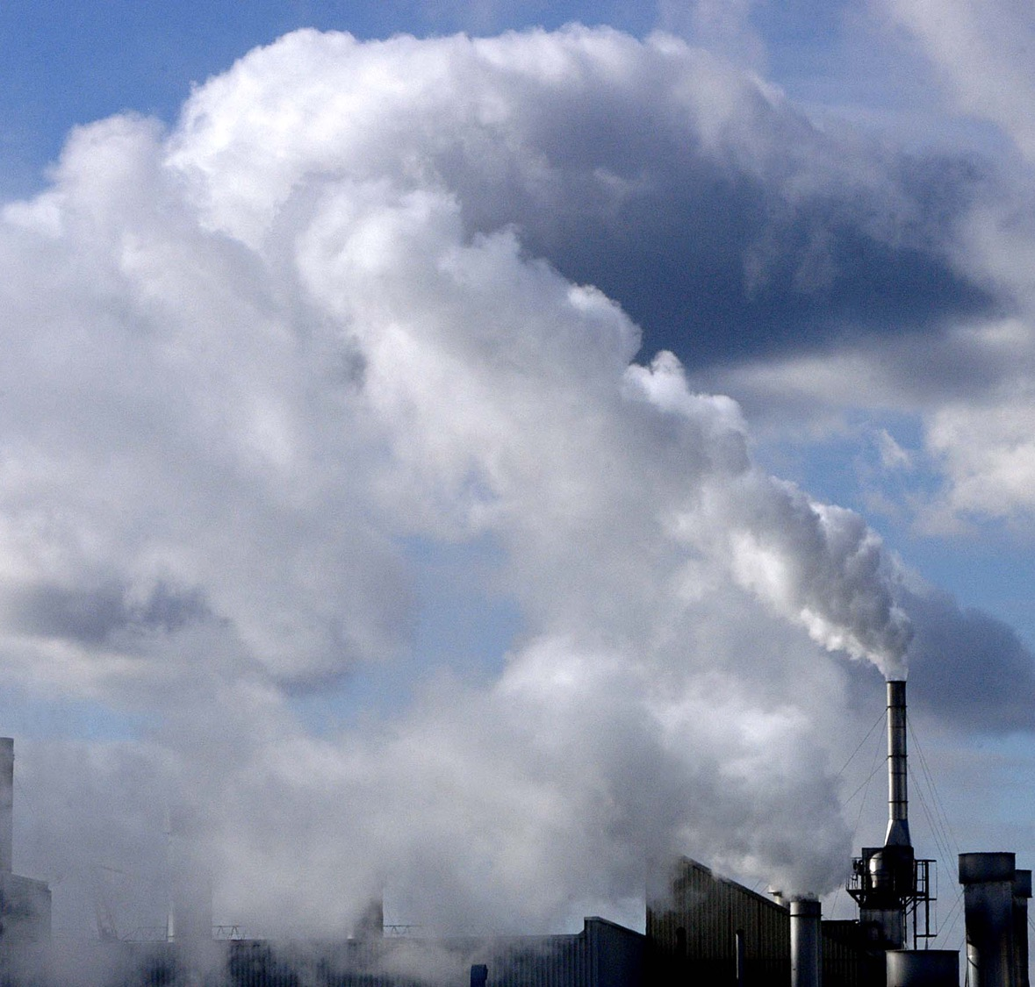
The problem with traditional ammonia
Traditional production
Energy intensive
Polluting: Massive refineries
To produce a litre of ammonia = one of highest concentration of greenhouse gas emissions
To date, clean production is too expensive
2 - 4 times more than traditional production
TSXV: NHHH OTCQB: NHHHF
•

Slide 16

Our Carbon-free NH3
Takes air, water and sustainable electricity and converts into non-polluting:
Chemical
Fertilizer
Fuel for engines, fuel cells
Ideal for energy production and grid storage
Perfect carrier of hydrogen for hydrogen economy
FuelPositive’s production system is affordable
Takes 30% less energy to produce than traditional production
TSXV: NHHH OTCQB: NHHHF
•
Notes:
However, our system is designed to utilize significantly less energy than traditional ammonia production. Our systems take air, water and a sustainable source of electricity to produce a carbon-free and non-polluting form of ammonia. The resulting ammonia can be utilized in agriculture as a carbon-free fertilizer or as a fossil fuel replacement in internal combustion engines and our carbon-free ammonia can replace the existing manufacturing processes that use dirty ammonia today.
See additions of energy production and grid storage – and carrier of hydrogen Dr. Dincer and his team have designed a carbon-free NH3 system that, even in phase 1 development, showed 30% less energy requirement to produce a litre of ammonia as compared to existing carbon-based production systems. Our expectation is to increase those efficiencies in the systems we are building today with NATIONAL COMPRESSED AIR for demonstration and commercialization purposes.

Slide 17
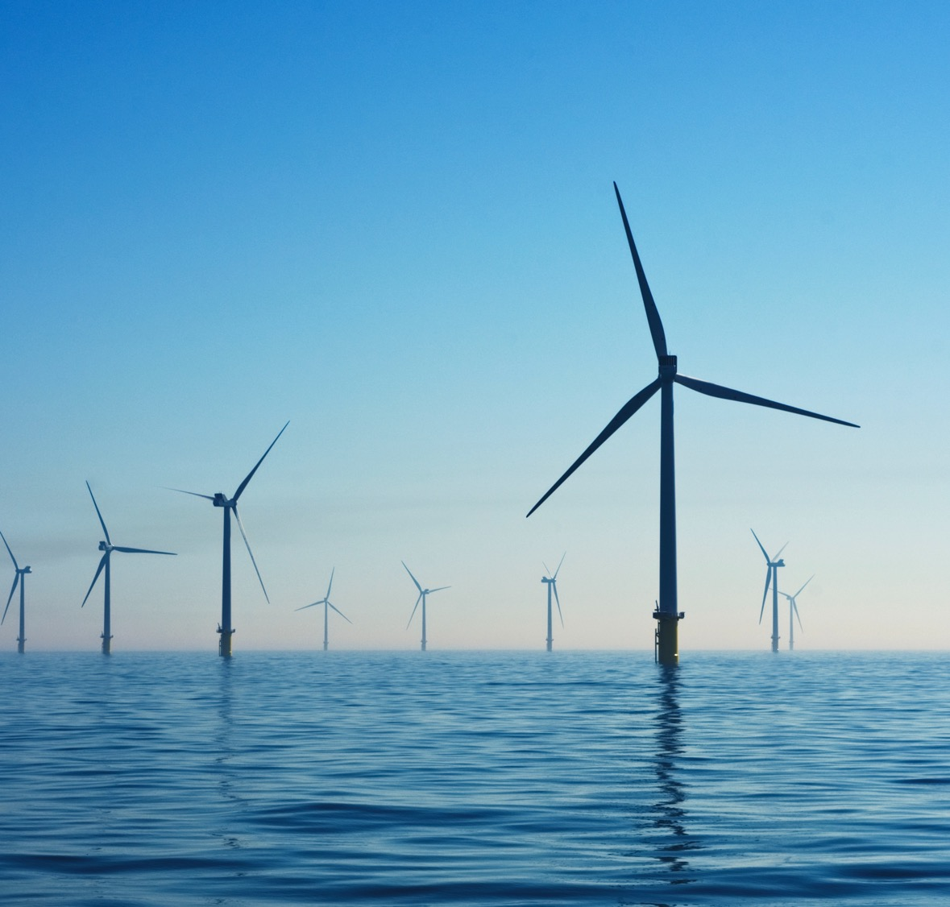
FuelPositive’s System
Phase 2 commercial demonstration prototypes currently in development
Modular, scalable
Easily transported
Size of shipping containers
Onsite production
Output/unit will produce commercially viable quantity of liquid carbon-free NH3
Pilot projects in place Q1 2022
TSXV: NHHH OTCQB: NHHHF
•
Notes:
The prototypes that are currently in production are built around highly versatile 20- and 40-foot container footprints, so that our modular and scalable systems can be easily deployed around the world. These phase 2 systems are also being built to produce commercially viable quantities of carbon-free ammonia for end users to utilize in their operations.

Slide 18
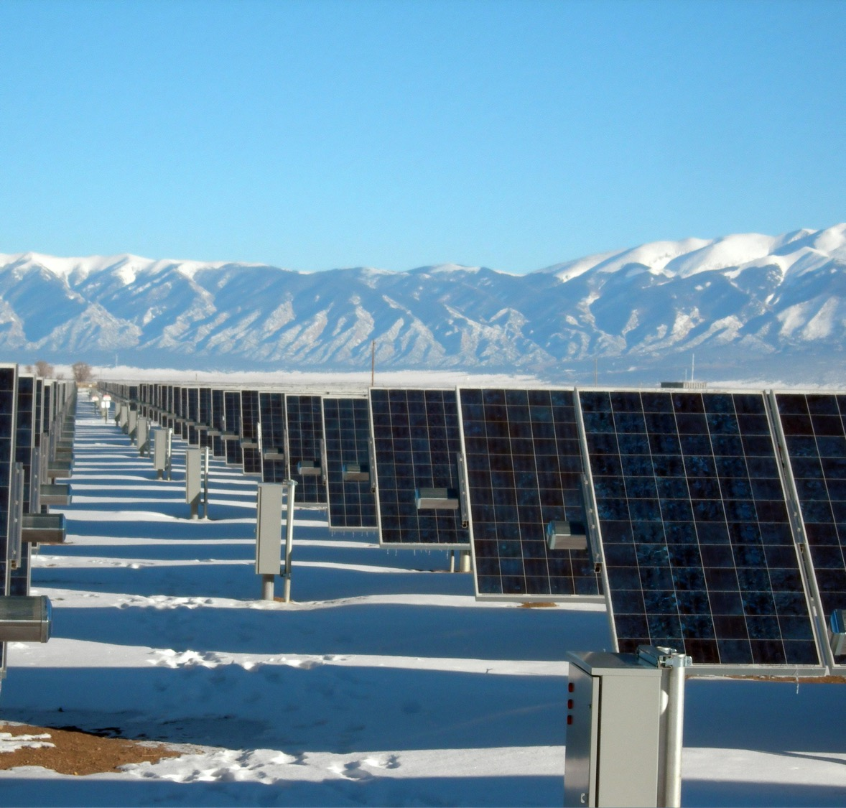

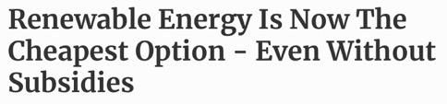
Will there be enough clean electricity?
Producing clean NH3 requires a clean electricity source, e.g., hydroelectric, solar, wind, geo-thermal
Forecasts are strong and prices dropping
Massive global green movement, initiatives, targets
TSXV: NHHH OTCQB: NHHHF
•

Slide 19

Is ammonia safe?
Green NH3 is safer than what we have now
Ignites at extremely high temperature (651C)
Much higher than gasoline, diesel, propane)
Lighter than air, rises when released
Dissipates into atmosphere without polluting
Detectable smell alerts people to go down-wind
NOx can be avoided with catalytic convertors and deep fertilizer injection
Resultant emission from our NH3 fuel is water vapor
TSXV: NHHH OTCQB: NHHHF
•
Notes:
There are also a lot of questions about whether NH3 is a significant form of pollution. When NH3 is used properly, in agriculture or in the future as a fossil fuel replacement fuel, the only discernable emissions should simply be water vapor, or in the case of agriculture, some hydrogen emissions which are completely inert. But keep in mind that utilizing current dirty Ammonia in any of these applications leaves and enormous carbon footprint! That’s why a carbon-free alternative, as developed by FuelPositive, is essential to achieve true zero emissions related to the utilization of ammonia.

Slide 20

The Hydrogen Economy
Hydrogen is the goal, but faces many challenges:
Production is energy intensive
End-product is highly volatile
Requires extreme pressure to store
Escapes at normal temperatures and leaks into structure of metals, making them brittle
Distribution infrastructure is virtually non-existent
Transportation has severe safety concerns
Solutions are years away
TSXV: NHHH OTCQB: NHHHF
•

Slide 21

Our NH3: Makes Hydrogen Economy POSSIBLE NOW
Our NH3 system requires 30% less energy than conventional NH3 production, with no carbon emissions
Our NH3 stores 65% more hydrogen than highly compressed hydrogen
No “boiling off”
No extreme compression
No cracking of brittle metals
Lower cost from start to finish
Easy to store and transport, using existing infrastructure
TSXV: NHHH OTCQB: NHHHF
•

Slide 22

Agriculture
80% of world’s NH3 is used for fertilizer, to get nitrogen into soil
Problems
Greenhouse gases from NH3 production
Supply chain uncertainty
FuelPositive system creates NH3 in situ/onsite
Farmers produce what they need, whenever needed
Injected into soil
Use as energy source and fuel to power farm equipment, replacing propane
TSXV: NHHH OTCQB: NHHHF
•

Slide 23

Why not just use manure?
Manure contains ammonia and also polluting methane, nitrous oxide
Farmers spray liquified manure on soil, releasing gaseous ammonia
Rain and run-off pollute waterways and water tables
Resting piles of manure release gaseous ammonia into atmosphere, which becomes pollutant when mixed with other airborne pollutants
TSXV: NHHH OTCQB: NHHHF
•
Notes:
But what’s wrong with using animal manure as a fertilizer? Not only is animal protein farming unsustainable in the near term, the utilization of animal manure as a fertilizer has huge negative environmental effects globally. Typically, farmers will spray their fields with liquified animal manure which will release the naturally formed ammonia into the air which then combines with other pollutants to create very negative air quality issues. Then the nitrogen that is sitting on the surface of the field instead of deep in the soil where it’s needed, is prone to runoff into lakes and rivers that can add even more detrimental environmental affect.
The solution that FuelPositive carbon-free ammonia systems provide for, eliminates the need for very heavily polluting animal manure fertilizing practises around the world.

Slide 24

Transportation
Carbon-free NH3 can replace gasoline and diesel at lower cost/distance travelled
Straightforward to convert engines
Kit similar to those converting gas and diesel engines to run on propane and natural gas
Leverage existing fossil fuel infrastructure
Gas stations could produce fuel on site
Aviation, marine, shipping/freight sectors need solutions now
TSXV: NHHH OTCQB: NHHHF
•

Slide 25
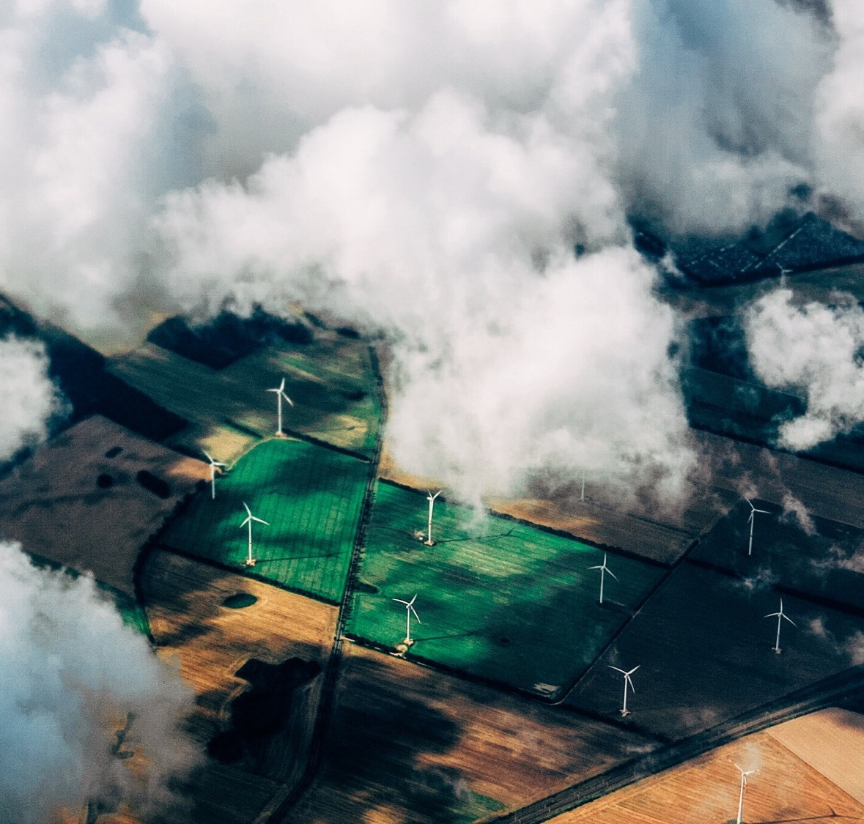
Grid Storage
Wherever renewables are
Problem with renewables is no storage mechanism
Storage is now possible with our carbon-free NH3
Excess is stored onsite through creation of carbon-free NH3
When needed, carbon-free NH3 is released to power clean turbines to generate clean electricity, avoiding propane
Potential to use solar panels in north in summer, storing it for use in winter
TSXV: NHHH OTCQB: NHHHF
•

Slide 26

Carbon Credits
Significant revenue from carbon credits will fund future growth and investment in new technologies
Each ton of carbon-free NH3 will reduce carbon emissions by more than 4 tons
2.5 carbon credits per ton for fertilizer and up to 5 for fuel applications in Canada
Potentially higher in other jurisdictions
TSXV: NHHH OTCQB: NHHHF
•

Slide 27
Summary: Fuel Positive
Completed C$5 million financing
Current cash balance is over C$6 million
Secures system prototype development
Filed key provisional patent
Dr. Ibrahim Dincer (inventor) and team central to roll-out
Prototype systems to be completed by end of 2021
TSXV: NHHH OTCQB: NHHHF
•

Slide 28

Summary: Our Carbon-free NH3
End fertilizer-related agriculture emissions
Enable hydrogen economy, almost immediately
Clean up transportation
Power fuel cells
Produce and store power for grids
Decentralize power grids
Reduce costs
TSXV: NHHH OTCQB: NHHHF
•

Slide 29

FuelPositive
Financially solid
Protecting/expanding our patents
Securing expertise
Exploring new, complementary technologies
Developing partnerships
On track with initial demonstration products that offer huge potential
Aggressively developing prototypes and setting up pilot projects
TSXV: NHHH OTCQB: NHHHF
•
Notes:
A few last things to highlights in relation to the health of the company are as follows: After raising $5 million a few weeks ago, we are on a solid financial footing and well-positioned to execute against our business plan. Our intellectual program is well underway, and we have great support through not only Dr. Dincer and his team but our great counsel at Cassels Brock. We’re building our team carefully and effectively and with the goal to ensure that we hire the most effective team members and consultants to execute our plans.
We also believe that through effective government relations and public relations, work we‘ll successfully attract the most meaningful partnerships in our space to ensure that our solutions are deployed globally with the right partners. And in order to get there we need to build the best phase 2 demonstration systems that we can, and we’re extremely pleased with the progress we are making on that front with NATIONAL COMPRESSED AIR and Dr. Dincer‘s team

Slide 30
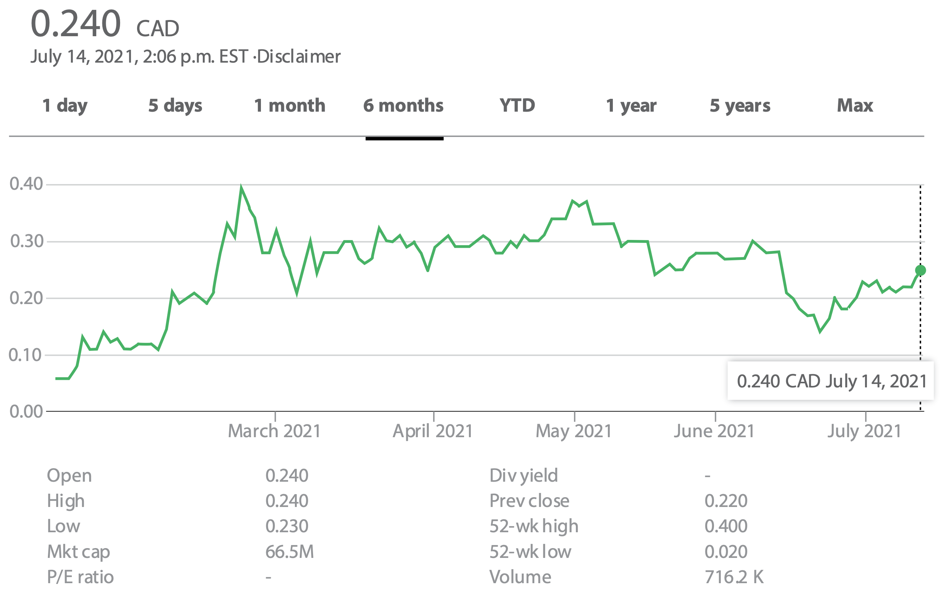
Share Metrics
Capital structure
Trading History: Six Months
TSXV: NHHH OTCQB: NHHHF | TSXV: NHHH OTC: ZNNMF
Share Price | C$0.24
52-Week Price Range | C$0.02-C$0.40
Market Cap | C$66.5 M
Shares Outstanding (Basic) | 277,403,662
Warrants | 63,504,054
Options | 26,282,5000
Fully Diluted Shares | 367,190,216
Management, Board & Insider Ownership | ~10%
•
TSXV: NHHH OTCQB: NHHHF
•
Notes:
Finally, we are also extremely pleased with the performance of the stock over the last year and I’m also very happy with the new quality of institutional shareholders that are taking meaningful positions in the stock. We have great advisers on the financial markets side of the equation and things are moving steadily forward with consistency and a real genuine attempt to under promise and over deliver in every aspect of the business.

Slide 31

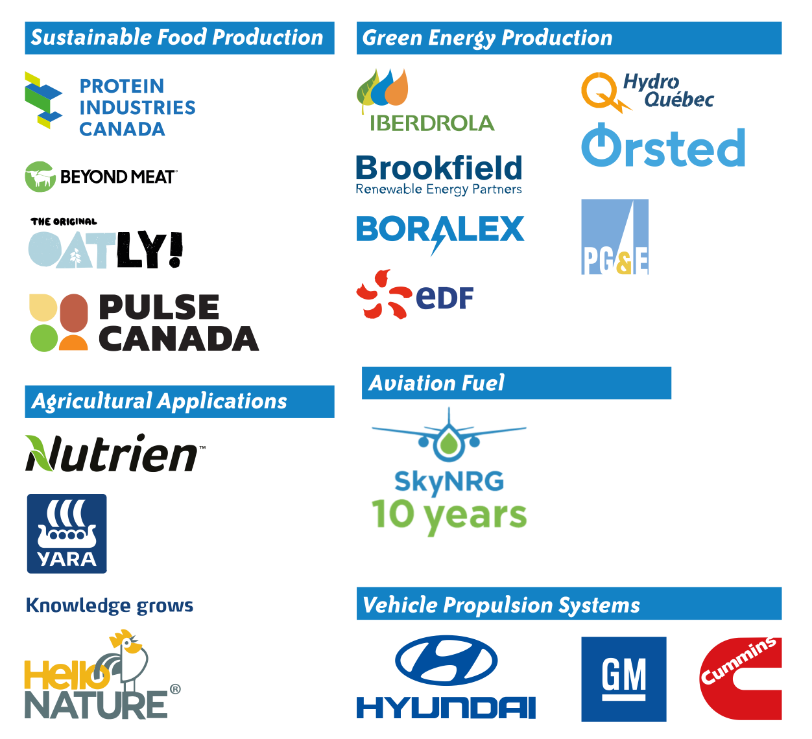
Potential Partnerships
TSXV: NHHH OTCQB: NHHHF
•
Notes:
So, thank you so much for your attention during the presentation and I hope that I’ve answered a lot of your questions and look forward to conducting many more of these webinars to keep all our stakeholders apprised of the progress that FuelPositive is making on a regular basis. I’ll take a few questions now and I apologize if I don’t get to your question in this portion of the program. We’ve got hundreds of people participating so we can only handle so many questions in the timeframe! We do promise to get back to all of you either directly or through our frequently asked questions section of our website Thanks again and over to you David.

Slide 32
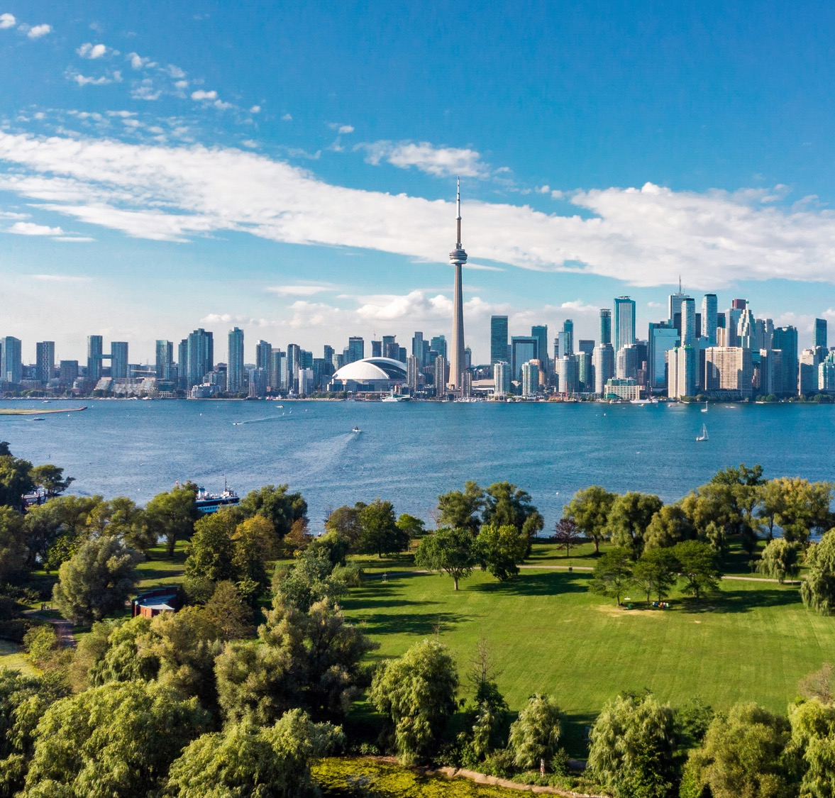
Contact Information
Mr. Ian Clifford Chief Executive Officer investors@fuelpositive.com www.fuelpositive.com Investor Relations (United States) RBMG – RB Milestone Group LLC Trevor Brucato, Managing Director fuelpositive@rbmilestone.com www.rbmilestone.com
Corporate Communications: InvestorBrandNetwork (IBN) Los Angeles, CA www.IBN.fm 310.299.1717 Office Editor@NetworkNewsWire.com
TSXV: NHHH OTCQB: NHHHF
•

